Slide 1
DESIGN OF AUGMENTED REALITY AND VIRTUAL REALITY
- ROHAN N KALPAVRUKSHA
ROSHAN N KALPAVRUKSHA

Slide 2
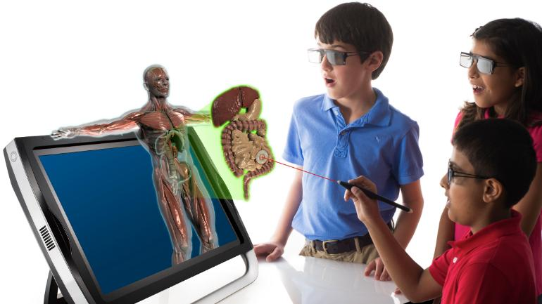
AUGMENTED REALITY
Easily improve his experience by changing his point of view.
Watch with a much stronger illusion of reality.
Be provided with a much more immersive user experience
AR immerses the learner in a virtual world is associated with a higher level of active learner participation.

Slide 3
WORKING PRINCIPLE
AR captures a part of the environment using a camera on a smartphone, tablet.
Then scans the captured piece of the environment to identify a point where to overlay additional information using infrared, laser, GPS, or sensors.
Later AR solution requests predefined content to overlay further an environmental footprint with additional information.
The solution forms a complete image consisting of the real-world background and overlaid AR data.
The approaches behind the immersive technology are SLAM, Markers, Position

Slide 4
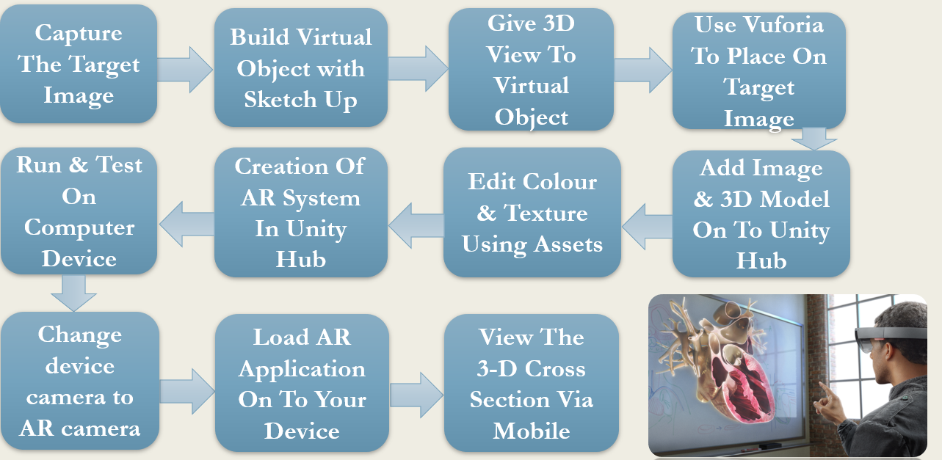

Slide 5
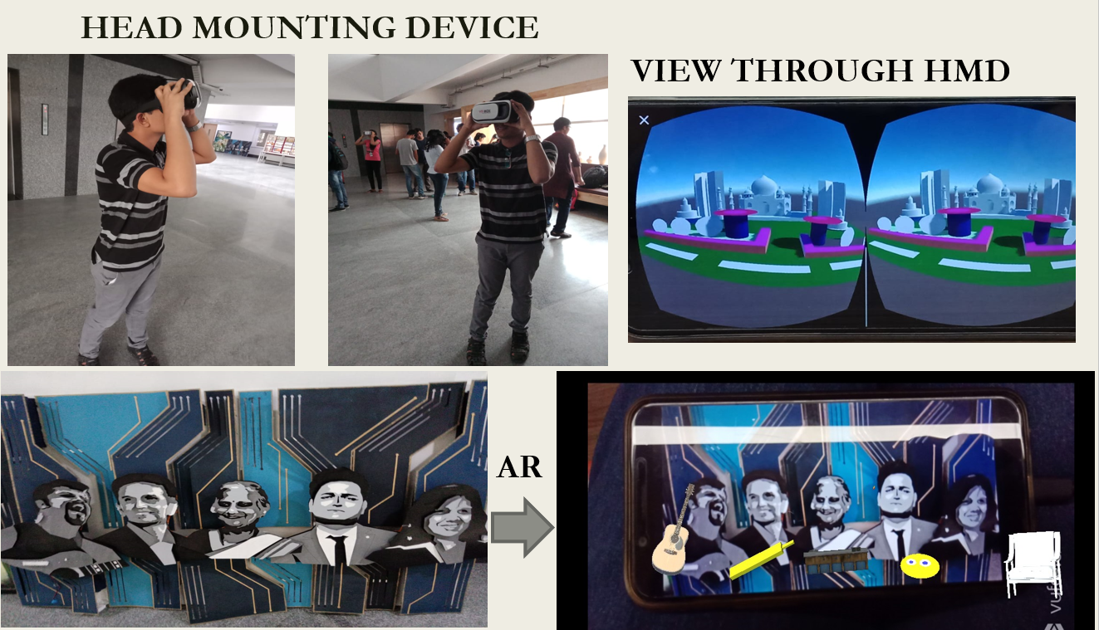

Slide 6
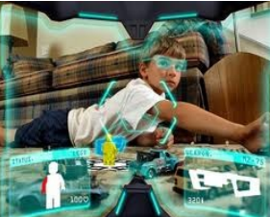
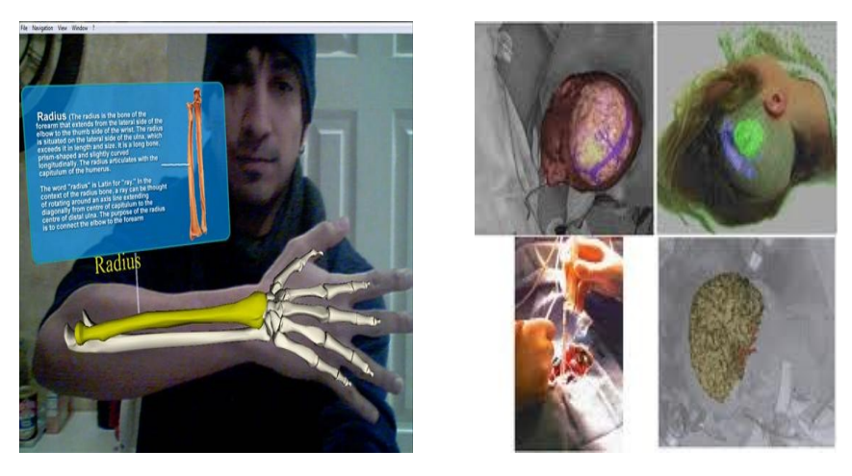

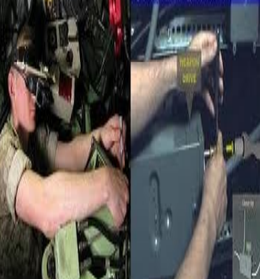
APPLICATIONS

Slide 7
UNITY HUB AND VUFORIA
The Unity Hub is a management tool that you can use to manage all of your Unity Projects and installations. Use the Hub to manage multiple installations of the Unity Editor along with their associated components, create new Projects, and open existing Projects.
You can download it on windows with C:\Program Files\Unity\Hub\Editor
Vuforia Engine is a software development kit (SDK) for creating Augmented Reality apps. Developers can easily add advanced computer vision functionality to any application, allowing it to recognize images and objects, and interact with spaces in the real world

Slide 8
How to create a AR system
The Vuforia Engine package can be added to a Unity project from a Git URL
Start by adding an ARCamera. This is a Unity camera game object that includes the VuforiaBehaviour to add support for augmented reality apps for both handheld devices and digital eyewear.
Steps:
Add an ARCamera GameObject from the Vuforia Engine menu.
Select the ARCamera and Open Vuforia Configuration from the Inspector
Add a Vuforia Development License Key in the App License Key field. For a guide on getting a license key, see Vuforia License Manager

Slide 9
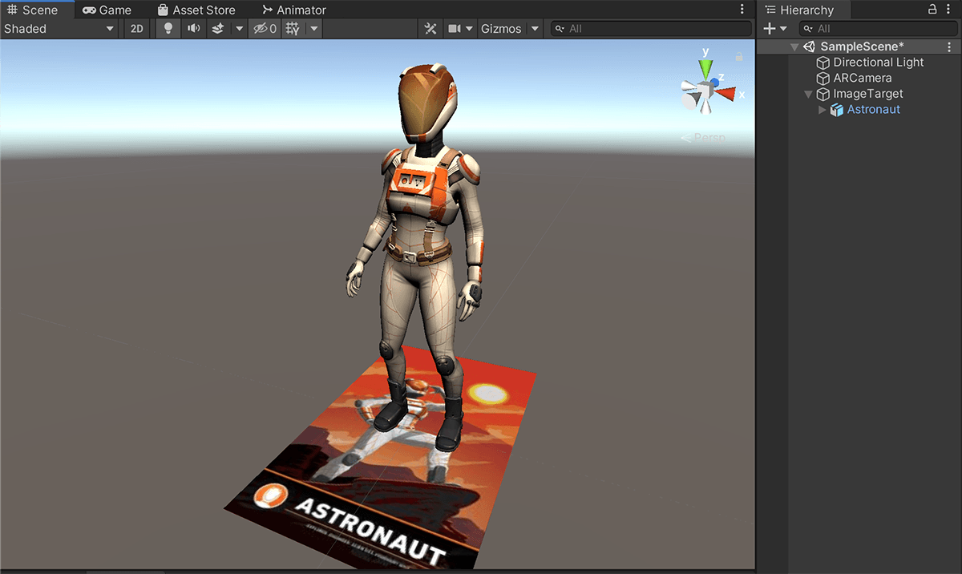
Navigate to the Vuforia Engine Menu and select Image Target. or any of the other targets you wish to use. For configurations for using other targets, please consult the Features Overview linked just above. It presents Unity guides for each Vuforia target.
Select the Image Target GameObject from the Hierarchy.
Add content as a child of the target by dragging your content on top of the target. This can also be a simple Cube from GameObject -> 3D Object -> Cube or you can place content from Unity’s Asset Store and even from our Core Samples as pictured above.
To see your scene in action you can use the Vuforia Engine Play Mode in the Game View that you can activate by pressing the Play button. You can use this feature to evaluate and rapidly prototype your scene(s) without having to deploy to a device.

